Slide 1
Affect Classification in Tweets using Multitask Deep Neural Networks

Slide 2
Problem
Twitter is widely used for information sharing and spreading
Spread, and diffusion of information is influenced by affect, such as hate, abuse, sarcasm, irony, pun etc., present in a tweet
Affect detection in micro-blogs is an active area of research
Affect is a crucial aspect when a user decides to retweet a tweet or not, motivated us to jointly model the two tasks, affect detection and retweet modelling
In this approach, a deep multi-task neural network for detecting affect-retweet pairs for tweets is proposed

Slide 3
Solution
Each task given to our network jointly learns a given affect, such as hate, sarcasm etc., along with learning retweeting behaviour as an auxiliary task, from a given tweet corpus
Modelling this as a multi-task network provides the advantage of learning from the two (related) tasks jointly
On test data, this model allows us to predict retweet behaviour (which is essential to downstream modelling of information spread) in the absence of any further meta-data and identifying affect in the data.
As a practical implication, this allows us also to predict whether a tweet with affect, e.g., a hateful or a sarcastic tweet, would go viral or not, and thereby enable end-users to plan appropriately, such as, prepare to defend a viewpoint, or take it down etc.

Slide 4
Input Construction
Tweet Text
Meta-data based Feature Construction
Tweet based features:
From the tweet text, we extract following features: count of hashtags, count of mentions, count of emoticons, the count of words in uppercase letters, and the count of URLs present
User-based Features:
From the author profiles, we extract following popularity and activity-related features: count of followers and friends, count of tweets posted, count of favourite tweets and the count of subscribed lists

Slide 5
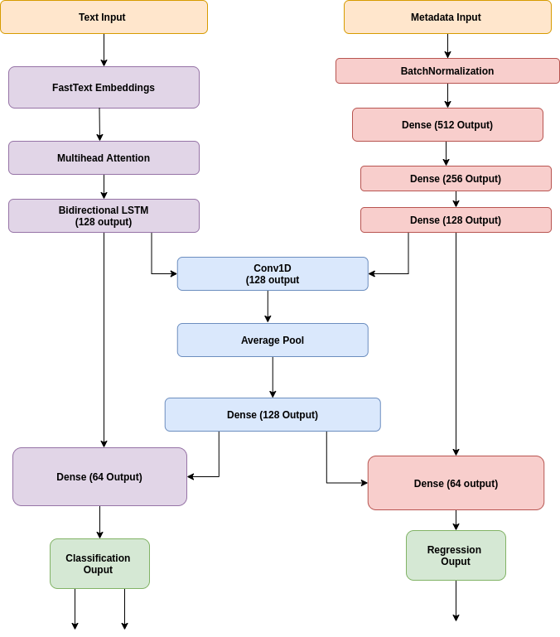
Network Architecture
Classification Layers
Shared Private Layers
Regression Layers for Auxiliary Task

Slide 6
Experiments
Dataset
Hate dataset from the paper, “Large Scale Crowdsourcing and Characterization of Twitter Abusive Behavior” published in ICWSM, 2018
We pick hateful, abusive and normal from the hate dataset, and club hateful and abusive in the class of hate. This makes the classification binary
Sarcasm dataset from the paper “Sarcasm detection on twitter: A behavioral modeling approach” published in WSDM, 2015

Slide 7
Experiments (cont’d)
Meta-data based Feature Construction
Tweet-based Features (TF): From the tweet text: count of hashtags, count of mentions, count of emoticons, the count of words in uppercase letters, and count of URLs present.
User-based Features (UF): From the author profiles, we extract popularity and activity-related features: count of followers and friends, count of tweets posted, count of favourite tweets and the count of subscribed lists.
Experimental Setup
Sparse categorical cross-entropy loss and mean square error loss as loss functions for the classification and regression task respectively and Adam as the optimization function.
We have standard split for the train (80%), test (10%) and validation (10%).
Preprocess using the tweet-preprocessor library
Comparison with state-of-the-art approach [9] and four other baselines
Baselines:
A: Here, remove the auxiliary branch for retweet count prediction and train for a single task.
B: Here, retain the multi-task nature of the network. However, instead of using contextual word embedding and Multihead Attention, we feed Glove embeddings directly to the LSTM layer.
C: Here, train a Naive Bayes model, using the TF-IDF weights for each tweet. top 5000 most frequently occurring tokens as the vocabulary
D: The same features as in baseline C are used to train a linear regression model for retweet count prediction.
[9] Antigoni Maria Founta, Despoina Chatzakou, Nicolas Kourtellis, Jeremy Blackburn, Athena Vakali, and Ilias Leontiadis. 2019. A unified deep learning architecture for abuse detection. In ACM WebSci. 105–114.

Slide 8
Results
Retweet Statistics
Performance metrics
[9] xAntigoni Maria Founta, Despoina Chatzakou, Nicolas Kourtellis, Jeremy Blackburn,
Athena Vakali, and Ilias Leontiadis. 2019. A unified deep learning architecture
for abuse detection. In ACM WebSci. 105–114.

